Slide 1
Angular-js Contd…

Slide 2
Controllers..
In Angular, a Controller is defined by a JavaScript constructor function that is used to augment the Angular Scope.
When a Controller is attached to the DOM via the ng-controller directive, Angular will instantiate a new Controller object, using the specified Controller's constructor function. A new child scope will be created and made available as an injectable parameter to the Controller's constructor function as $scope.
If the controller has been attached using the controller as syntax then the controller instance will be assigned to a property on the new scope.
Use controllers to:
Set up the initial state of the $scope object.
Add behavior to the $scope object.
Do not use controllers to:
Manipulate DOM — Controllers should contain only business logic. Putting any presentation logic into Controllers significantly affects its testability. Angular has databinding for most cases and directives to encapsulate manual DOM manipulation.
Format input — Use angular form controls instead.
Filter output — Use angular filters instead.
Share code or state across controllers — Use angular services instead.
Manage the life-cycle of other components (for example, to create service instances).

Slide 3
Controller-Inheritance
Binding controllers with $compile

Slide 4
Filters
Filters can be added to expressions and directives using a pipe character. AngularJS filters can be used to transform data:
filter | Selects a subset of items from array and returns it as a new array.
currency | Formats a number as a currency (ie $1,234.56). When no currency symbol is provided, default symbol for current locale is used.
number | Formats a number as text.
date | Formats date to a string based on the requested format.
json | Allows you to convert a JavaScript object into JSON string.
lowercase | Converts string to lowercase.
uppercase | Converts string to uppercase.
limitTo | Creates a new array or string containing only a specified number of elements. The elements are taken from either the beginning or the end of the source array, string or number, as specified by the value and sign (positive or negative) oflimit. If a number is used as input, it is converted to a string.
orderBy | Orders a specified array by the expression predicate. It is ordered alphabetically for strings and numerically for numbers. Note: if you notice numbers are not being sorted as expected, make sure they are actually being saved as numbers and not strings. Array-like values (e.g. NodeLists, jQuery objects, TypedArrays, Strings, etc) are also supported.

Slide 5
Filters
AngularJS filters can be used to transform data:
filter | Selects a subset of items from array and returns it as a new array.
currency | Formats a number as a currency (ie $1,234.56). When no currency symbol is provided, default symbol for current locale is used.
number | Formats a number as text.
date | Formats date to a string based on the requested format.
json | Allows you to convert a JavaScript object into JSON string.
lowercase | Converts string to lowercase.
uppercase | Converts string to uppercase.
limitTo | Creates a new array or string containing only a specified number of elements. The elements are taken from either the beginning or the end of the source array, string or number, as specified by the value and sign (positive or negative) oflimit. If a number is used as input, it is converted to a string.
orderBy | Orders a specified array by the expression predicate. It is ordered alphabetically for strings and numerically for numbers. Note: if you notice numbers are not being sorted as expected, make sure they are actually being saved as numbers and not strings. Array-like values (e.g. NodeLists, jQuery objects, TypedArrays, Strings, etc) are also supported.

Slide 6
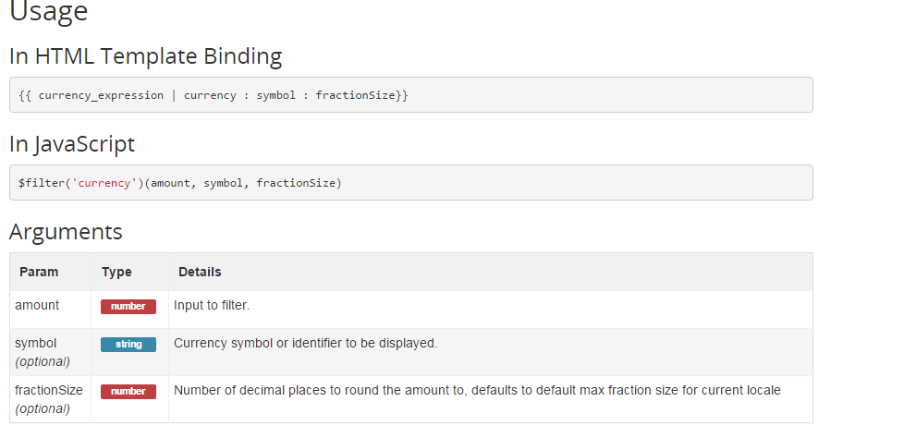
Currency

Slide 7
Usage
In HTML Template Binding
{{ number_expression | number : fractionSize}}
In JavaScript
$filter('number')(number, fractionSize)
Arguments
Number Filter
Param | Type | Details
number | numberstring | Number to format.
fractionSize(optional) | numberstring | Number of decimal places to round the number to. If this is not provided then the fraction size is computed from the current locale's number formatting pattern. In the case of the default locale, it will be 3.

Slide 8
For details on available filters go to:-
https://docs.angularjs.org/api/ng/filter

